Slide 1


Introduction to Wavelet
S
S
Bhushan D Patil
PhD Research Scholar
Department of Electrical Engineering
Indian Institute of Technology, Bombay
Powai, Mumbai. 400076
A₁
D₁
A₂
D₂
A₃
D₃

Slide 2
Outline of Talk
Overview
Historical Development
Time vs Frequency Domain Analysis
Fourier Analysis
Fourier vs Wavelet Transforms
Wavelet Analysis
Typical Applications
References

Slide 3
OVERVIEW
Wavelet
  A small wave
Wavelet Transforms
  Convert a signal into a series of wavelets
  Provide a way for analyzing waveforms, bounded in both frequency and duration
  Allow signals to be stored more efficiently than by Fourier transform
  Be able to better approximate real-world signals
  Well-suited for approximating data with sharp discontinuities
“The Forest & the Trees”
  Notice gross features with a large "window“
  Notice small features with a small

Slide 4
Historical Development
Pre-1930
  Joseph Fourier (1807) with his theories of frequency analysis
The 1930^{s}
  Using scale-varying basis functions; computing the energy of a function
1960-1980
  Guido Weiss and Ronald R. Coifman; Grossman and Morlet
Post-1980
  Stephane Mallat; Y. Meyer; Ingrid Daubechies; wavelet applications today

Slide 5
Mathematical Transformation
Why
  To obtain a further information from the signal that is not readily available in the raw signal.
Raw Signal
  Normally the time-domain signal
Processed Signal
  A signal that has been "transformed" by any of the available mathematical transformations
Fourier Transformation
  The most popular transformation

Slide 6
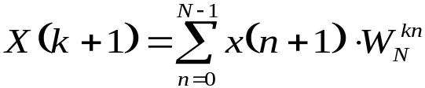
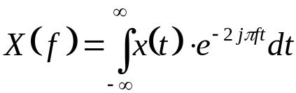
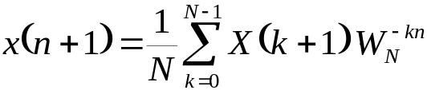
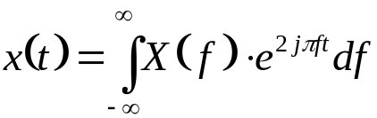

FREQUENCY ANALYSIS
Frequency Spectrum
  Be basically the frequency components (spectral components) of that signal
  Show what frequencies exists in the signal
Fourier Transform (FT)
  One way to find the frequency content
  Tells how much of each frequency exists in a signal

Slide 7
STATIONARITY OF SIGNAL
Stationary Signal
  Signals with frequency content unchanged in time
  All frequency components exist at all times
Non-stationary Signal
  Frequency changes in time
  One example: the “Chirp Signal”

Slide 8
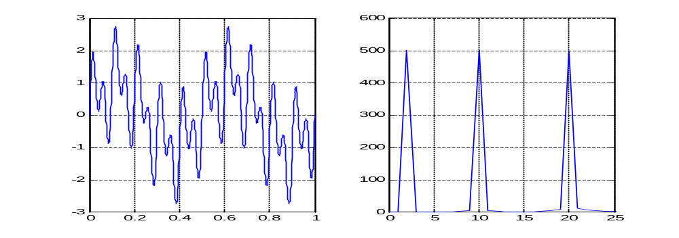
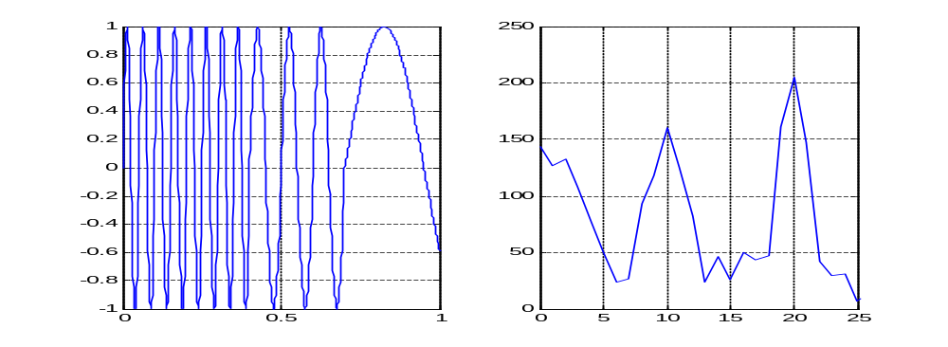
STATIONARITY OF SIGNAL
2 Hz + 10 Hz + 20Hz
Magnitude
Magnitude
Stationary
Time
Frequency (Hz)
0.0-0.4: 2 Hz +
0.4-0.7: 10 Hz +
0.7-1.0: 20Hz
Magnitude
Magnitude
Non-Stationary
Time
Frequency (Hz)

Slide 9
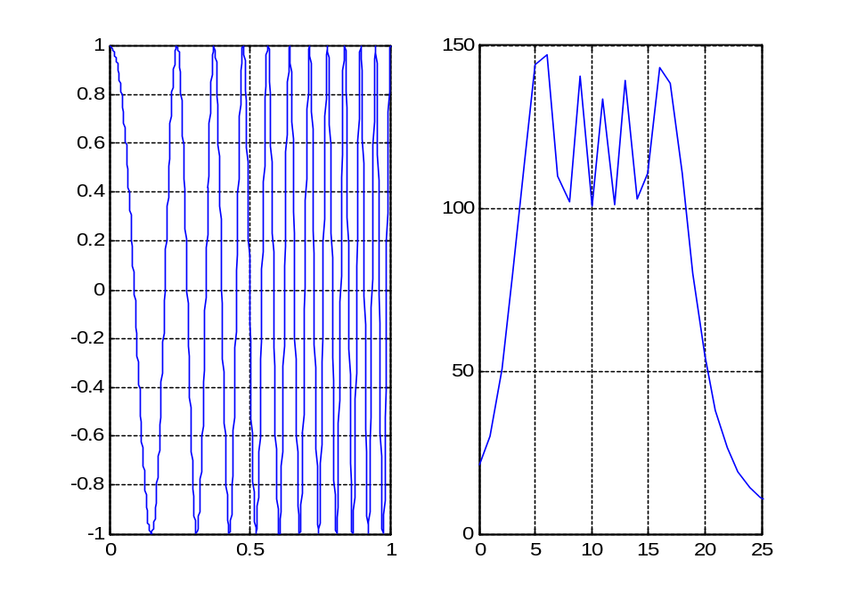
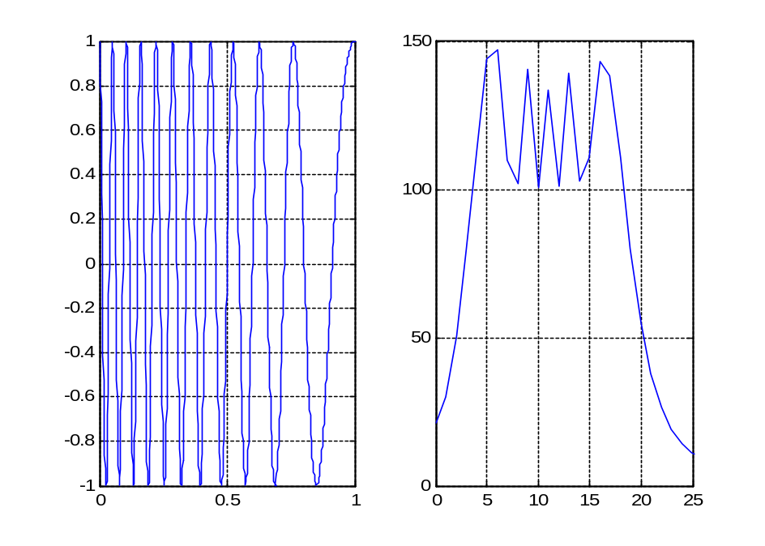
CHIRP SIGNALS
Frequency: 2 Hz to 20 Hz
Different in Time Domain
Frequency: 20 Hz to 2 Hz
Magnitude
Magnitude
Magnitude
Magnitude
Time
Frequency (Hz)
Time
Frequency (Hz)
Same in Frequency Domain
At what time the frequency components occur? FT can not tell!

Slide 10
NOTHING MORE, NOTHING LESS
FT Only Gives what Frequency Components Exist in the Signal
The Time and Frequency Information can not be Seen at the Same Time
Time-frequency Representation of the Signal is Needed
Most of Transportation Signals are Non-stationary.
(We need to know whether and also when an incident was happened.)
ONE EARLIER SOLUTION: SHORT-TIME FOURIER TRANSFORM (STFT)

Slide 11
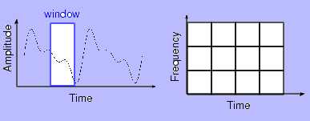
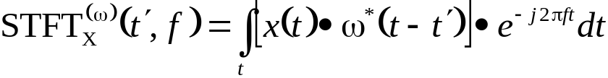

SFORT TIME FOURIER TRANSFORM (STFT)
Dennis Gabor (1946) Used STFT
  To analyze only a small section of the signal at a time -- a technique called Windowing the Signal.
The Segment of Signal is Assumed Stationary
A 3D transform
A function of time and frequency

Slide 12
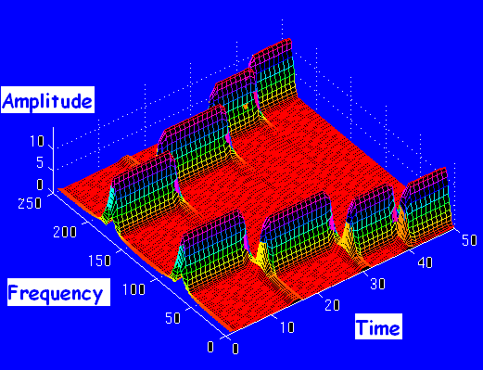
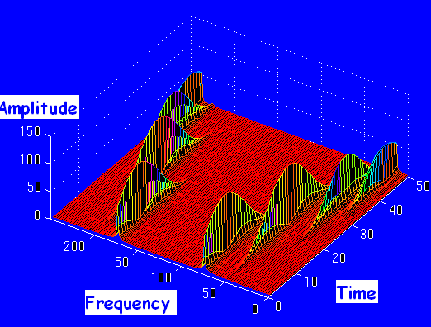
DRAWBACKS OF STFT
Unchanged Window
Dilemma of Resolution
  Narrow window -> poor frequency resolution
  Wide window -> poor time resolution
Heisenberg Uncertainty Principle
  Cannot know what frequency exists at what time intervals
Via Narrow Window
Via Wide Window

Slide 13
MULTIRESOLUTION ANALYSIS (MRA)
Wavelet Transform
  An alternative approach to the short time Fourier transform to overcome the resolution problem
  Similar to STFT: signal is multiplied with a function
Multiresolution Analysis
  Analyze the signal at different frequencies with different resolutions
  Good time resolution and poor frequency resolution at high frequencies
  Good frequency resolution and poor time resolution at low frequencies
  More suitable for short duration of higher frequency; and longer duration of lower frequency components

Slide 14
PRINCIPLES OF WAELET TRANSFORM
Split Up the Signal into a Bunch of Signals
Representing the Same Signal, but all Corresponding to Different Frequency Bands
Only Providing What Frequency Bands Exists at What Time Intervals

Slide 15
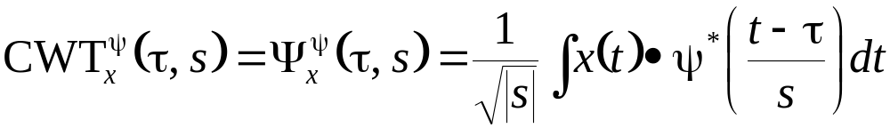
DEFINITION OF CONTINUOUS WAVELET TRANSFORM
Translation
(The location of the window)
Scale
Mother Wavelet
Wavelet
  Small wave
  Means the window function is of finite length
Mother Wavelet
  A prototype for generating the other window functions
  All the used windows are its dilated or compressed and shifted versions

Slide 16
SCALE
Scale
  S>1: dilate the signal
  S<1: compress the signal
Low Frequency -> High Scale -> Non-detailed Global View of Signal -> Span Entire Signal
High Frequency -> Low Scale -> Detailed View Last in Short Time
Only Limited Interval of Scales is Necessary

Slide 17
COMPUTATION OF CWT
Step 1: The wavelet is placed at the beginning of the signal, and set s=1 (the most compressed wavelet);
Step 2: The wavelet function at scale “1” is multiplied by the signal, and integrated over all times; then multiplied by ;
Step 3: Shift the wavelet to t= , and get the transform value at t= and s=1;
Step 4: Repeat the procedure until the wavelet reaches the end of the signal;
Step 5: Scale s is increased by a sufficiently small value, the above procedure is repeated for all s;
Step 6: Each computation for a given s fills the single row of the time-scale plane;
Step 7: CWT is obtained if all s are calculated.

Slide 18
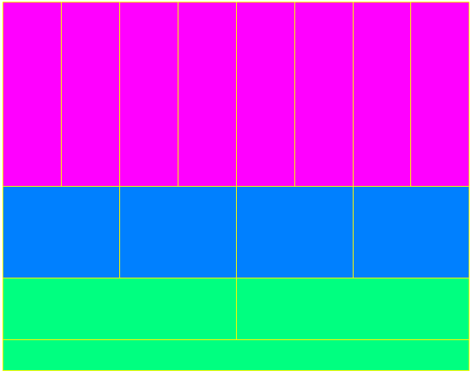
RESOLUTION OF TIME & FREQUENCY
Better time resolution;
Poor frequency resolution
Frequency
Better frequency resolution;
Poor time resolution
Time
Each box represents a equal portion
Resolution in STFT is selected once for entire analysis

Slide 19
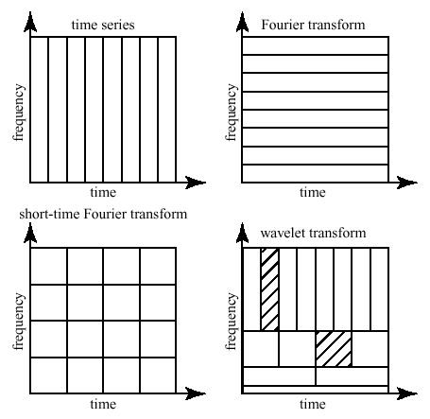
COMPARSION OF TRANSFORMATIONS
From http://www.cerm.unifi.it/EUcourse2001/Gunther_lecturenotes.pdf, p.10

Slide 20
DISCRETIZATION OF CWT
It is Necessary to Sample the Time-Frequency (scale) Plane.
At High Scale s (Lower Frequency f ), the Sampling Rate N can be Decreased.
The Scale Parameter s is Normally Discretized on a Logarithmic Grid.
The most Common Value is 2.
The Discretized CWT is not a True Discrete Transform
Discrete Wavelet Transform (DWT)
  Provides sufficient information both for analysis and synthesis
  Reduce the computation time sufficiently
  Easier to implement
  Analyze the signal at different frequency bands with different resolutions
  Decompose the signal into a coarse approximation and detail information

Slide 21
Multi Resolution Analysis
Analyzing a signal both in time domain and frequency domain is needed many a times
  But resolutions in both domains is limited by Heisenberg uncertainty principle
Analysis (MRA) overcomes this , how?
  Gives good time resolution and poor frequency resolution at high frequencies and good frequency resolution and poor time resolution at low frequencies
  This helps as most natural signals have low frequency content spread over long duration and high frequency content for short durations

Slide 22
SUBBABD CODING ALGORITHM
Halves the Time Resolution
  Only half number of samples resulted
Doubles the Frequency Resolution
  The spanned frequency band halved
0-1000 Hz
256
X[n]512
Filter 1
D₁: 500-1000 Hz
256
Filter 2
D₂: 250-500 Hz
S
S
A₁
128
A₁
D₁
128
Filter 3
D₃: 125-250 Hz
A₂
64
A₂
D₂
A₃: 0-125 Hz
A₃
D₃
64

Slide 23
RECONSTRUCTION
What
  How those components can be assembled back into the original signal without loss of information?
  A Process After decomposition or analysis.
  Also called synthesis
How
  Reconstruct the signal from the wavelet coefficients
  Where wavelet analysis involves filtering and down sampling, the wavelet reconstruction process consists of up sampling and filtering

Slide 24
WAVELET APPLICATIONS
Typical Application Fields
  Astronomy, acoustics, nuclear engineering, sub-band coding, signal and image processing, neurophysiology, music, magnetic resonance imaging, speech discrimination, optics, fractals, turbulence, earthquake-prediction, radar, human vision, and pure mathematics applications
Sample Applications
  Identifying pure frequencies
  De-noising signals
  Detecting discontinuities and breakdown points
  Detecting self-similarity
  Compressing images

Slide 25
REFERENCES
Mathworks, Inc. Matlab Toolbox http://www.mathworks.com/access/helpdesk/help/toolbox/wavelet/wavelet.html
Robi Polikar, The Wavelet Tutorial, http://users.rowan.edu/~polikar/WAVELETS/WTpart1.html
Robi Polikar, Multiresolution Wavelet Analysis of Event Related Potentials for the Detection of Alzheimer's Disease, Iowa State University, 06/06/1995
Amara Graps, An Introduction to Wavelets, IEEE Computational Sciences and Engineering, Vol. 2, No 2, Summer 1995, pp 50-61.
Resonance Publications, Inc. Wavelets. http://www.resonancepub.com/wavelets.htm
R. Crandall, Projects in Scientific Computation, Springer-Verlag, New York, 1994, pp. 197-198, 211-212.
Y. Meyer, Wavelets: Algorithms and Applications, Society for Industrial and Applied Mathematics, Philadelphia, 1993, pp. 13-31, 101-105.
G. Kaiser, A Friendly Guide to Wavelets, Birkhauser, Boston, 1994, pp. 44-45.
W. Press et al., Numerical Recipes in Fortran, Cambridge University Press, New York, 1992, pp. 498-499, 584-602.
M. Vetterli and C. Herley, "Wavelets and Filter Banks: Theory and Design," IEEE Transactions on Signal Processing, Vol. 40, 1992, pp. 2207-2232.
I. Daubechies, "Orthonormal Bases of Compactly Supported Wavelets," Comm. Pure Appl. Math., Vol 41, 1988, pp. 906-966.
V. Wickerhauser, Adapted Wavelet Analysis from Theory to Software, AK Peters, Boston, 1994, pp. 213-214, 237, 273-274, 387.
M.A. Cody, "The Wavelet Packet Transform," Dr. Dobb's Journal, Vol 19, Apr. 1994, pp. 44-46, 50-54.
J. Bradley, C. Brislawn, and T. Hopper, "The FBI Wavelet/Scalar Quantization Standard for Gray-scale Fingerprint Image Compression," Tech. Report LA-UR-93-1659, Los Alamos Nat'l Lab, Los Alamos, N.M. 1993.
D. Donoho, "Nonlinear Wavelet Methods for Recovery of Signals, Densities, and Spectra from Indirect and Noisy Data," Different Perspectives on Wavelets, Proceeding of Symposia in Applied Mathematics, Vol 47, I. Daubechies ed. Amer. Math. Soc., Providence, R.I., 1993, pp. 173-205.
B. Vidakovic and P. Muller, "Wavelets for Kids," 1994, unpublished. Part One, and Part Two.

Slide 26
Thank You

